Slide 1
Interactive Notebook Requirements
Ms. Reynolds
2015-2016

Slide 2
Cover Page
Content: Your cover should have the following basic elements in writing somewhere on the cover and easily readable:
  The name of the course
  The words: Interactive Student Notebook
  The class period
  The school year
  Teacher’s Name: Ms. Reynolds
  Your name

Slide 3
Page One- Author Page
Requirements: Divide into four sections
  Upper Left- About Me: (short self-description)
  Upper Right- Post-Secondary Plans (what you will do after high school)
  Lower Left- Favorite Part of History & An Explanation
  Lower Right- Three people you’d like to have dinner with and why? Dead or alive

Slide 4
Page Two- Policies
Copy the following policies onto page two (back of author’s page)
Care and upkeep of notebook is student’s responsibility!
Notebook must be brought to class daily
Notebook will be assessed at teacher’s discretion
Notebook will be kept up to date despite absences, excused or unexcused.

Slide 5
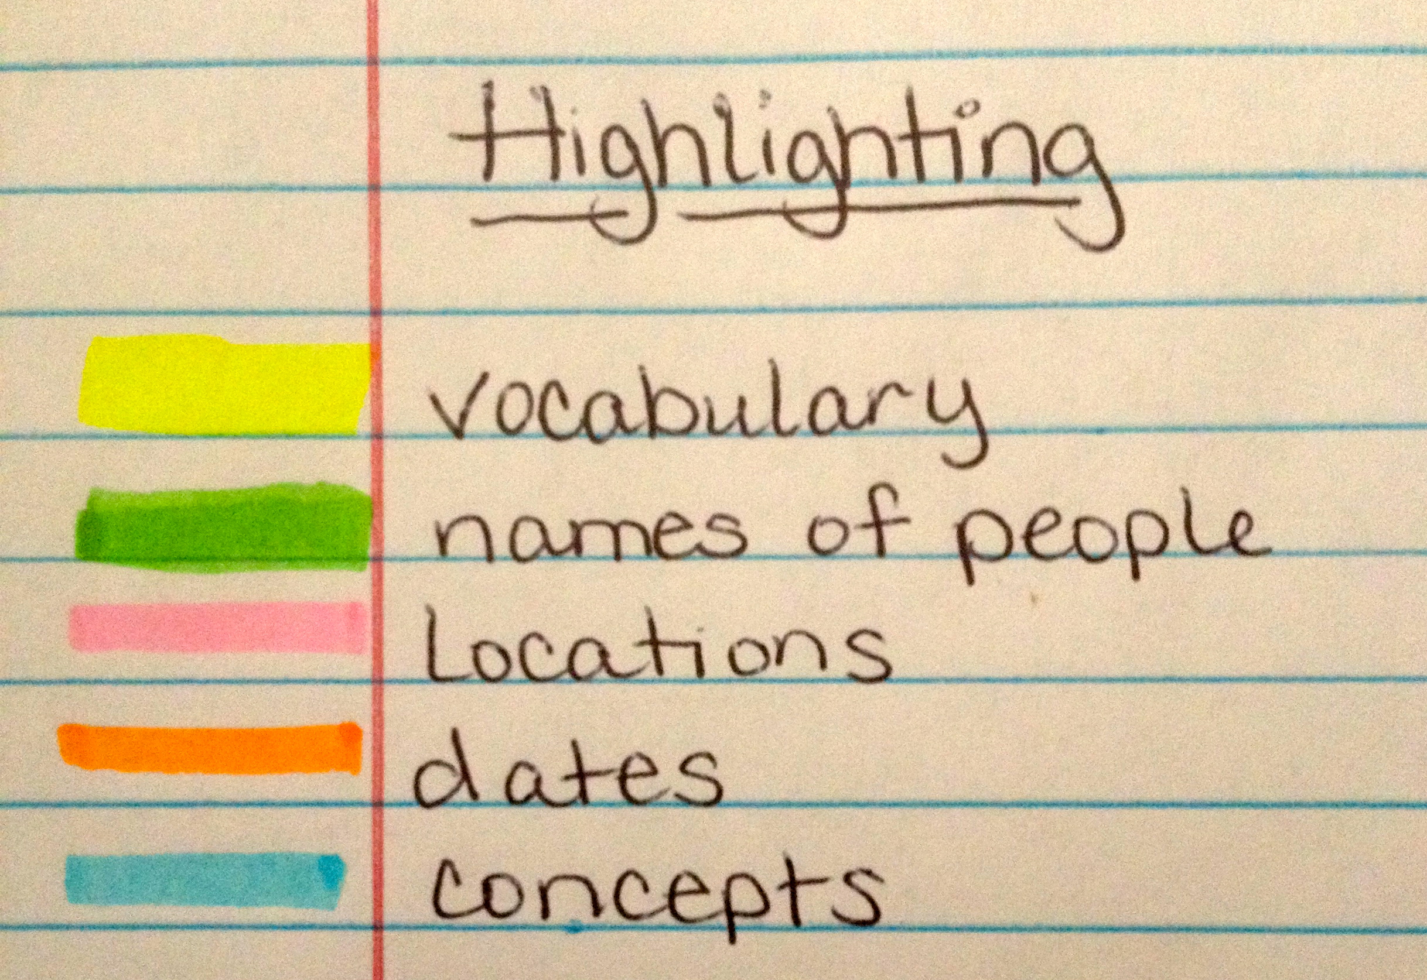
Page Two Continued-Highlighting Guide
(below Policies)
Choose your own colors for your highlighting guide

Slide 6
Table of Contents Pages 3-7
Page | Activity | Date
1 | Author Page | Complete by 7/27
2 | Guidelines/Rules | Complete by 7/27
3-7 | Table of Contents
8
9

